Slide 1
Analytics of Hospitals Health Care data
G.Pranav
G.Pranav
Hirthik Prasad
Varsha .K

Slide 2
Goal of the Project : To accurately predict the Length of Stay for each patient on case by case basis so that the Hospitals can use this information for optimal resource allocation and better functioning. The length of stay is divided into 11 different classes ranging from 0-10 days to more than 100 days.
Project objectives :
1. Know Fundamental concepts and can work on IBM Cognos analytics.
2. Gain a broad understanding of plotting different visualizations to provide the suitable solutions
3. Able to create meaningful visualizations and the dashboard(s).

Slide 3
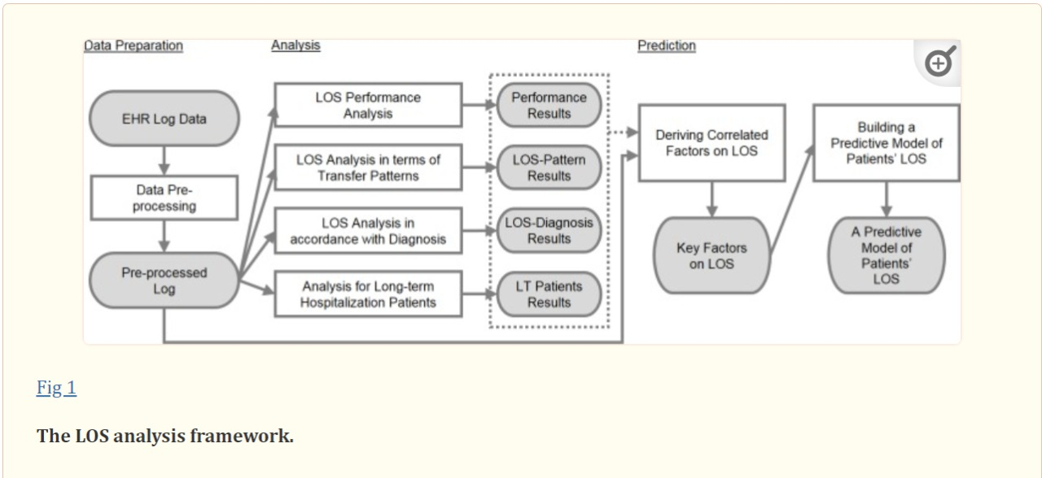
Length of stay Analysis Framework

Slide 4
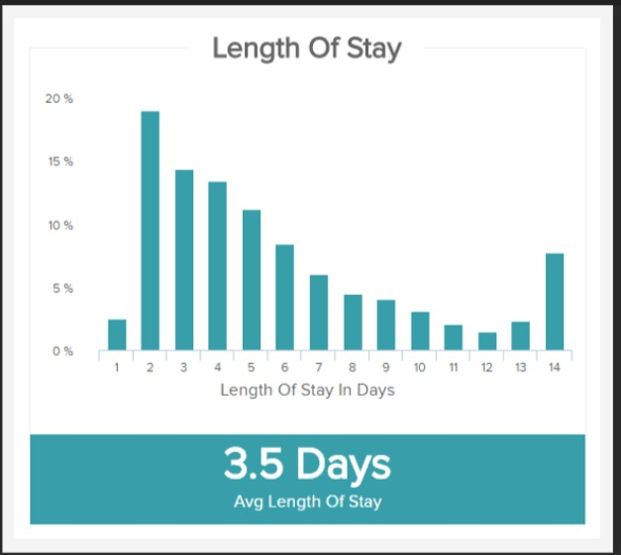
Average Length of Stay for all patients

Slide 5
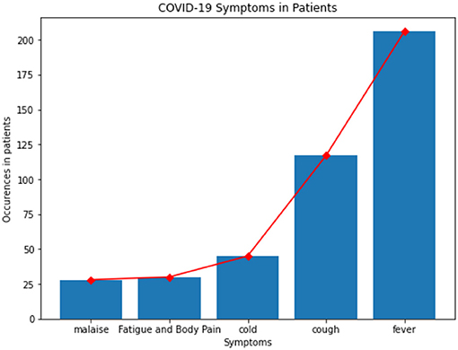
Length of stay depends of several parameters :
1)Symptoms of Patients

Slide 6
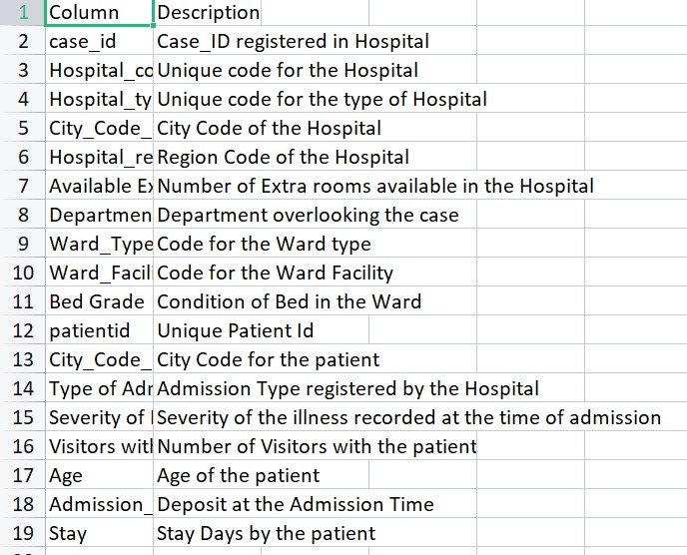
Few other parameters are :

